Slide 1
Social Mobility
Rafael Marques

Slide 2
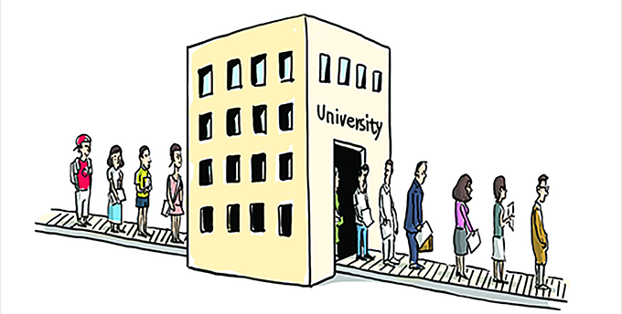
Social Mobility

Slide 3
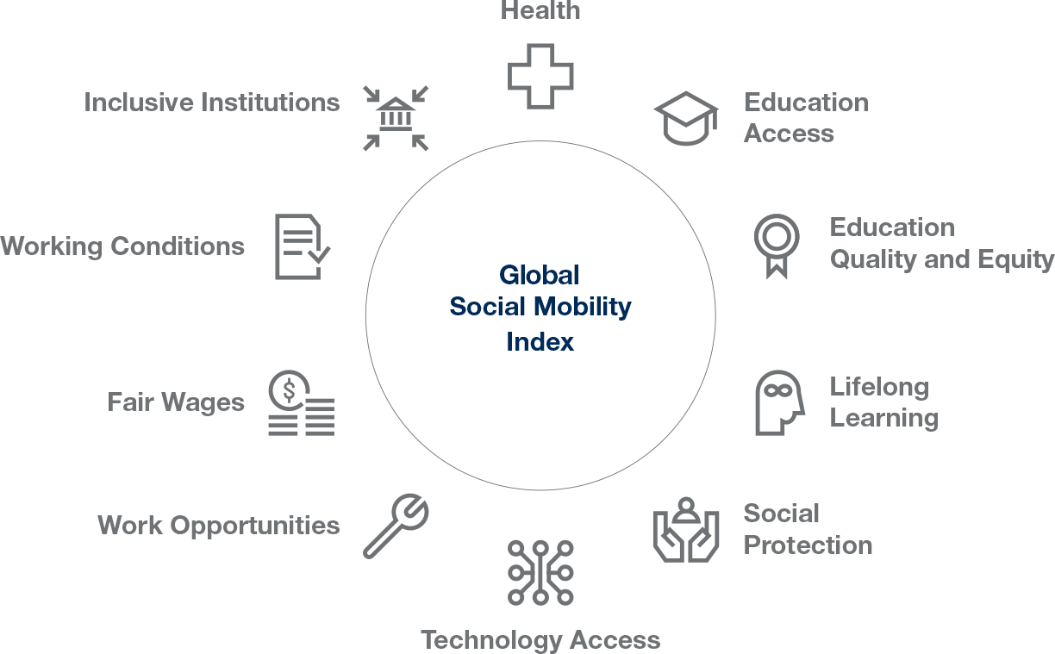
Social Mobility

Slide 4
Equality and Mobility

Slide 6
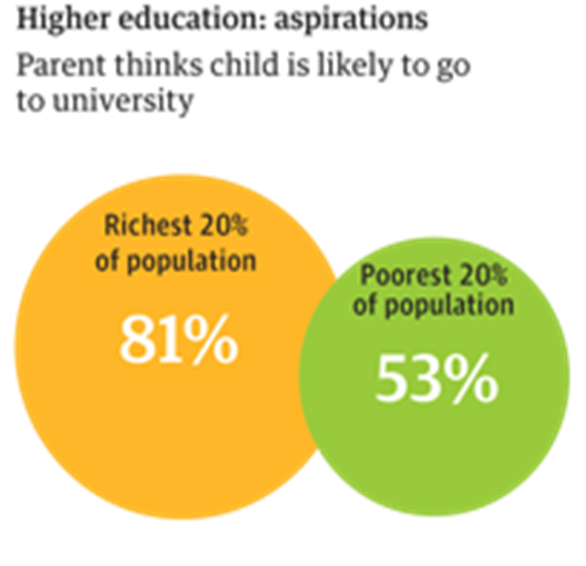
Achievement and Aspirations

Slide 7
Structural Mobility

Slide 8
Mobility
Horizontal mobility
Vertical mobility
2.1 Intragenerational mobility
2.2 Intergenerational mobility
3. Intergenerational mobility data
3.1 Open society
3.2 Social reproduction theory
3.3 Chosen data

Slide 9
Social mobility
Movement of individuals or groups in social structure
Measures the change in education, income, health status and literacy

Slide 10
1. Two directions of social mobility
Horizontal mobility
Vertical mobility

Slide 11
1. Horizontal mobility
Movement of individuals and groups within the same social class or the same level of hierarchy
Change of workplace without changing a position or change of residence

Slide 12
2. Vertical mobility
Going down (degradation) or up (social promotion) in the class structure or in the social hierarchy
Changes in the structure of society and re-evaluating the scale of social stratification
Higher vertical mobility is an indicator of the openness of the society

Slide 13
2.1 Intragenerational mobility
Movement of individuals between levels of the hierarchy
Degradation → other individuals or groups through their own social promotion raise the level in the hierarchy

Slide 14
2.2 Intergenerational mobility
Mobility of social categories from the position occupied by their parents
Measure → intergenerational elasticity
The higher the intergenerational elasticity, the less social mobility a society offers

Slide 16
Intragenerational Mobility

Slide 18
3. Intergenerational mobility data
Open society
versus
Social reproduction theory

Slide 19
3.1 Open society
Career advancement and social development are approved and expected
Non-ascribed positions = positions of members of this society are not assigned at birth

Slide 20
3.2 Social reproduction theory
Social inequality is transmitted from one generation to the next
Four kinds of capital:
Financial capital
Cultural capital
Human capital
Social capital
Intergenerational mobility doesn´t exist

Slide 21
3.3 Chosen data
United Kingdom
Studies on social mobility made by government
“you can reach the stars of career” no matter where you come from??

Slide 22
Jobs
24% of vice-chancellors
32% of members of Parliament
51% of top medics
54% of London Stock Exchange workers
54% of top journalists
70% of High Court judges
went to private school, though only 7% of the population do

